Slide 1
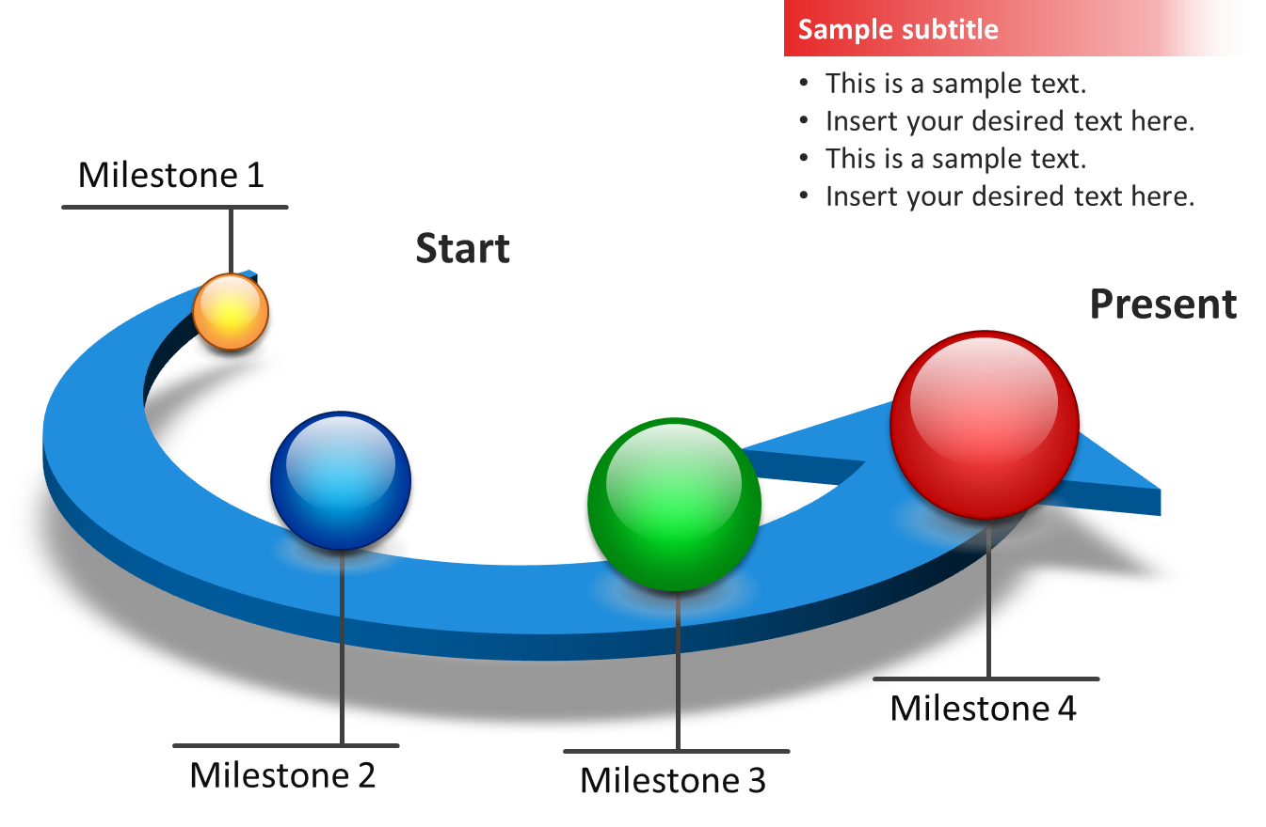
MISSION NLP
Srija Adusumilli , Teja Kommineni
Initialization:
Generate Similar words for type of Incident and Weapons.
Handling each slot in the template separately and
Tools - Princeton’s WordNet Library
True Case Library:
We have used the templates from Auto-Slog paper and extracted the matching patterns from training text and then used them in Regular expressions to fill Incident slot. We also employed the ranking technique mentioned earlier to filter the noise.
Issues - Before Midpoint evaluation we were using the raw text given to us as the inputs for various NLP tasks and we got poor precision. This is when we realized the importance of TrueCasing and it played a prominent role in increasing our F-Score.
Tools - TrueCase Library
Search and Rank:
To fill the weapons slot we scan the text and record all the words present in the weapons dictionary created in the initialization stage. We created a rank index to determine how close a word is to the weapons given in the project statement and the one which secures high rank is the winner.
Issues: Without the ranking scheme when we just scanned for words our precision was very low.
Tools – NLTK, Spacy
Named Entity Recognition:
We extracted a handful of organizations from training data and just did a linear search for the slot perp-organization.
Victims and Targets were handled by simply using the Auto-Slog templates by traversing the parse tree for objects and subjects.
Issues: Stanford library for NER is efficient but takes lot of time making the whole system slow. We used Spacy’s Noun chunks as an alternative to this but our F-Scores were affected by this.
Tools – RegEx.

